Slide 1

Big Data

Slide 2
What we will cover in this presentation?
What is Big Data?
How is it different from “small data”?
How will it impact our lives?
Is it a good thing?

Slide 3
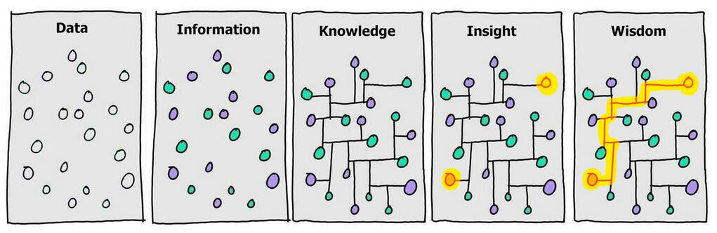
The Information Continuum
Cartoon by David Somerville, based on a two pane version by Hugh McLeod
Notes:
We’re all probably familiar with the Information → Knowledge → Wisdom information continuum. Data is just upstream of information. It is the raw material on which most information is based.

Slide 4
Types of Data
Quantitative Data
Measurable
Collected through measuring things that have a fixed reality
Close ended
Qualitative Data
Descriptive
Collected through observation, field work, focus groups, interviews, recording or filming conversations
Open ended

Slide 5

Big Data
Data that is too large or too complex to be managed using traditional data processing, analysis, and storage techniques.
Notes:
Enter Big Data. A common definition of Big Data is “data that is too large or too complex to be managed using traditional data processing, analysis, and storage techniques.”

Slide 6
The 4 V’s of Big Data
Volume The amount of data | Variety The types of data
Velocity The frequency of data | Veracity The quality of data
Notes:
Big Data is often referred to as having certain attributes, known as the 4 V’s: Volume, Variety, Velocity and Veracity.

Slide 7
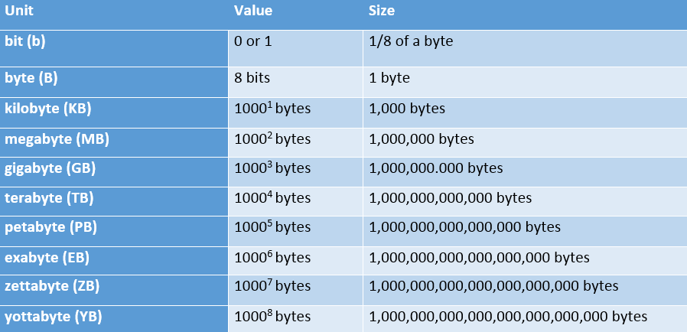

Volume: scale of data
Notes:
We’re all pretty familiar with file sizes in the kilobyte, megabyte, and gigabyte range. When it comes to Big Data, data files can exceed those numbers by several orders of magnitude. Data collections are so larger that they require special storage and analysis options. Enter Hadoop, an open-source software framework for storage and processing of big data sets. One of the creators, Doug Cutting, named it after his 2 year old son’s stuffed elephant.

Slide 8
Volume: scale of data
90% of today’s data has been created in just the last 2 years
Every day we create 2.5 quintillion bytes of data or enough to fill 10 million Blu-ray discs
40 zettabytes (4o trillion gigabytes) of data will be created by 2020, an increase of 300 times from 2005, and the equivalent of 5,200 gigabytes of data for every man, woman and child on Earth
Most companies in the US have over 100 terabytes (100,000 gigabytes) of data stored
Notes:
A few examples of the volume of data we are amassing…
The number are truly mind-boggling.
https://www.emc.com/leadership/digital-universe/2014iview/index.htm
http://www.infodocket.com/2014/04/16/how-large-is-the-digital-universe-how-fast-is-it-growing-2014-emc-digital-universe-study-now-available

Slide 9














Variety: different forms of data
Notes:
A good way to visualize the variety of Big Data available is to think of social media sites. When we think about varieties of data, it is helpful to also think of it as either structured or unstructured. Structured data is the kind of data we find in a fixed field in a record, file, or spreadsheet. Unstructured data refers to data that doesn’t follow a specific format. Think satellite images, photographs and video, social media data, and medical records.

Slide 10
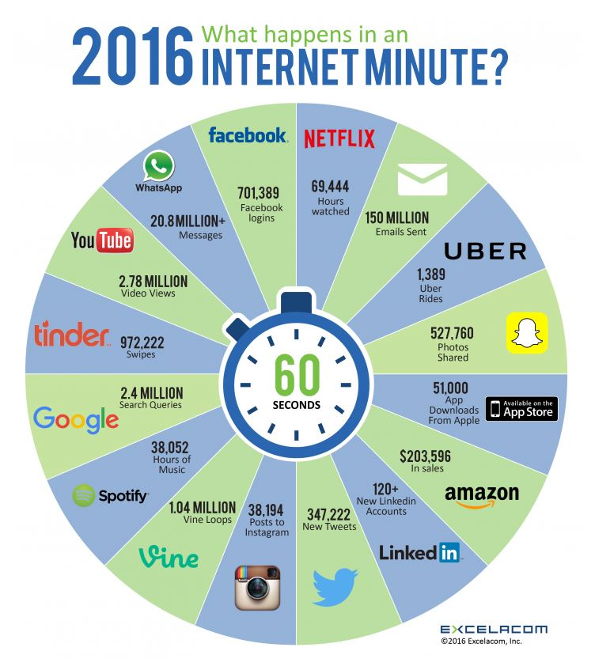
What happens in an Internet minute?
Notes:
Excela, Incorporated’s infographic demonstrates how much data was created in just one Internet minute in 2016…

Slide 11
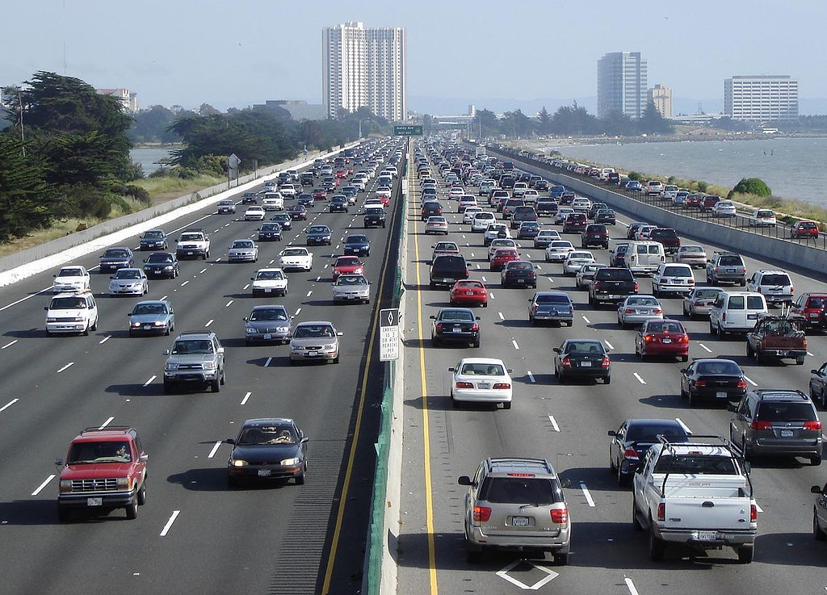

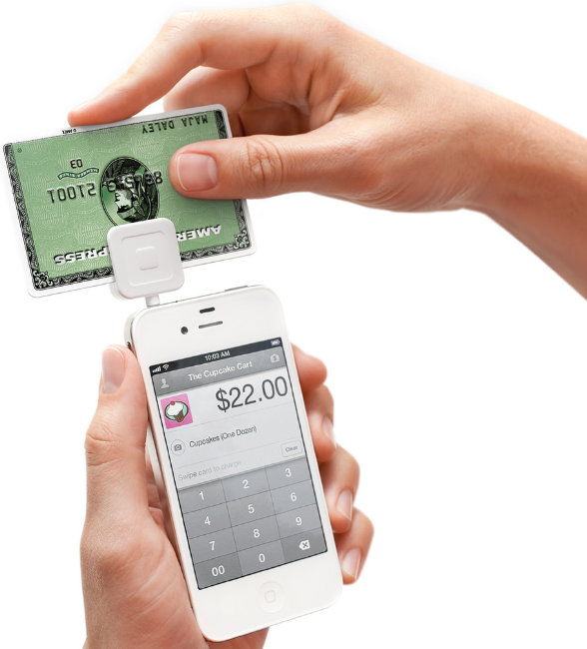

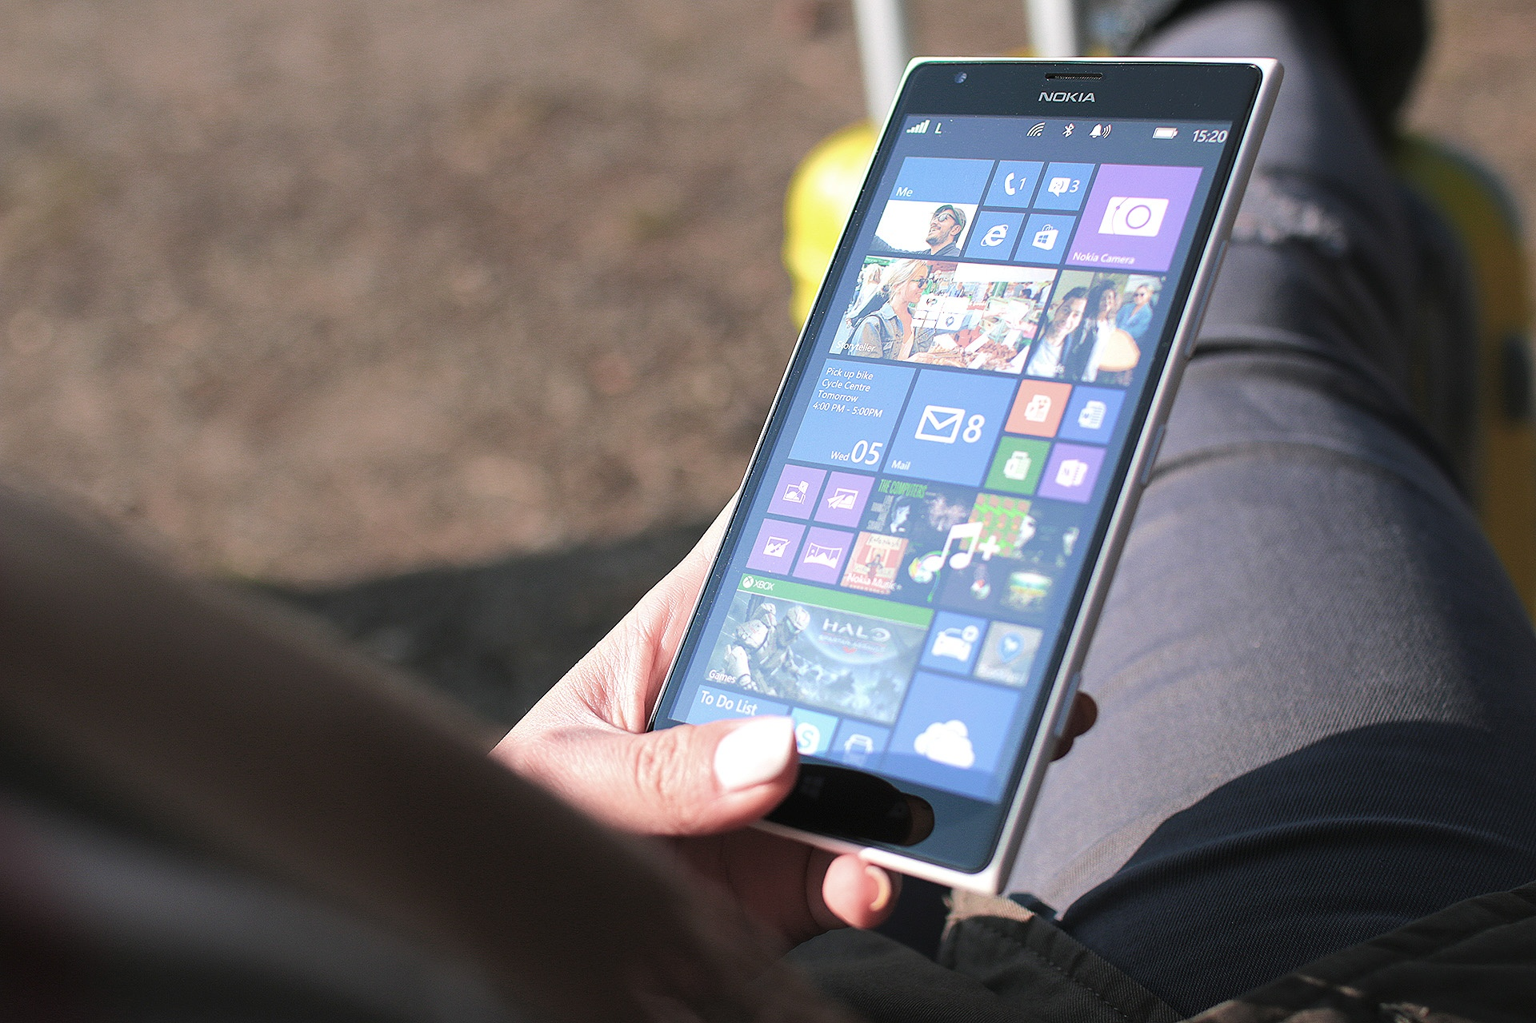

Velocity: analysis of streaming data
Notes:
Velocity refers to the frequency of incoming data that must be processed. Think text messages, Facebook status updates, credit card swipes, the multitude of sensors in modern cars, and the stock exchange.

Slide 12
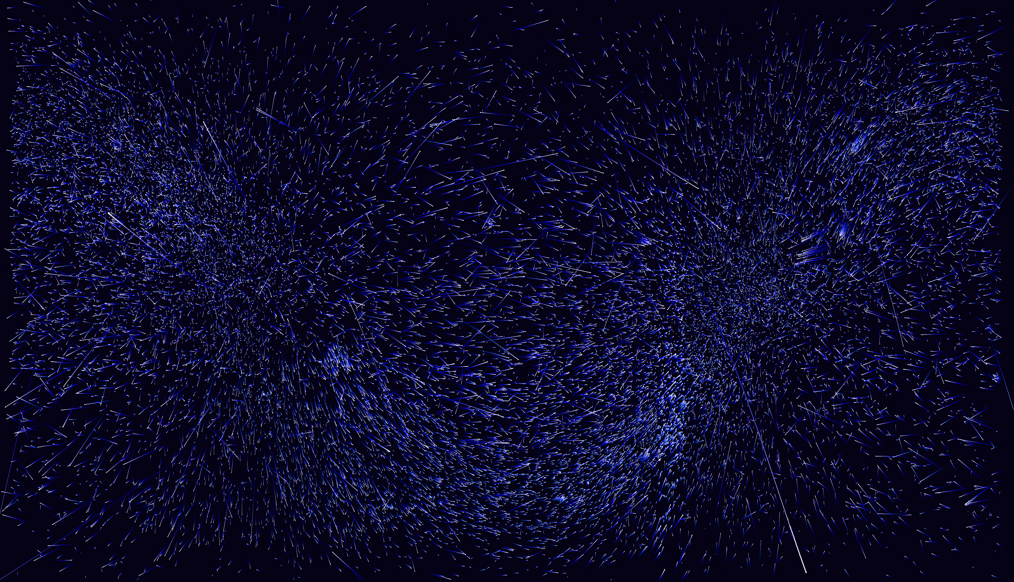
Veracity: trustworthiness of data
Origin
Authenticity
Trustworthiness
Completeness
Integrity
Notes:
Veracity refers to the trustworthiness of data. Librarians are familiar with this concept as it applies to information on the Internet.

Slide 13
The 4 V’s of Big Data
Value
Volume The amount of data | Variety The types of data
Velocity The frequency of data | Veracity The quality of data
Notes:
And finally, Value. Not all data is necessarily valuable data.

Slide 14
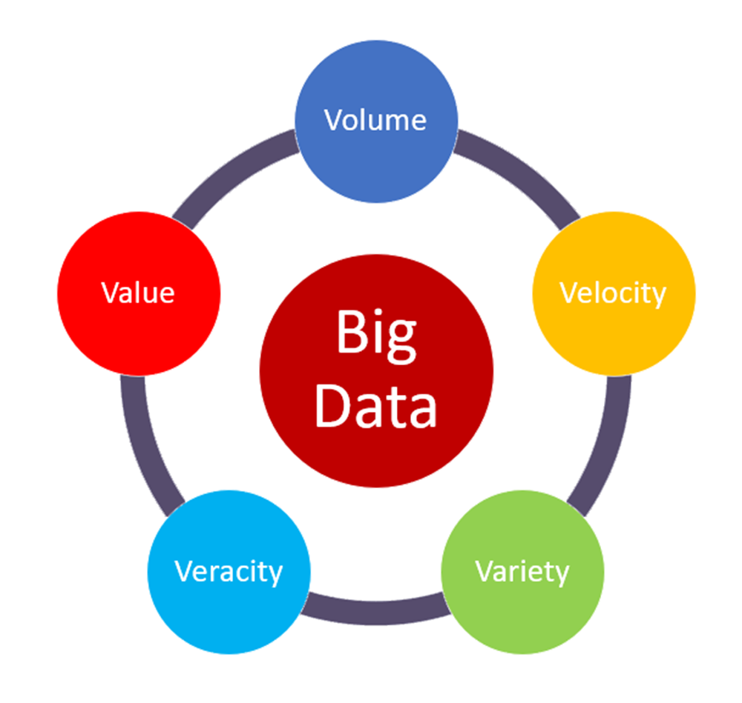

Slide 15
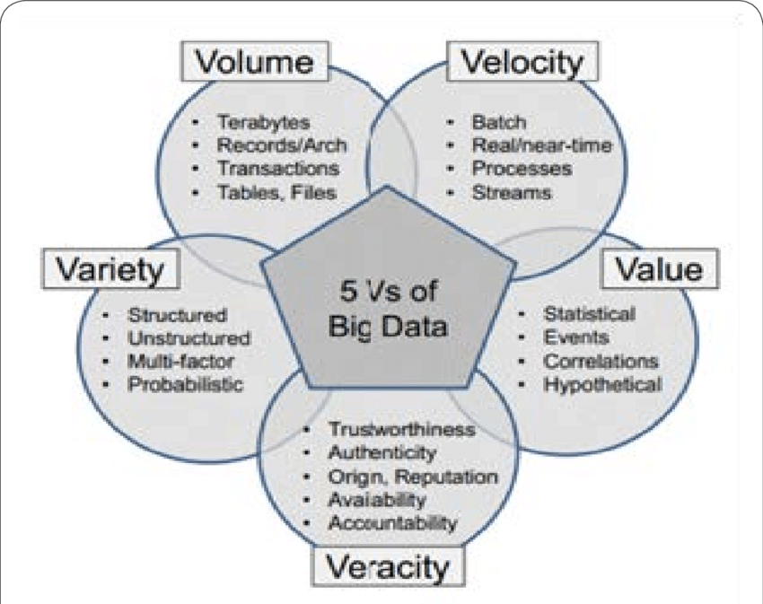

Slide 16
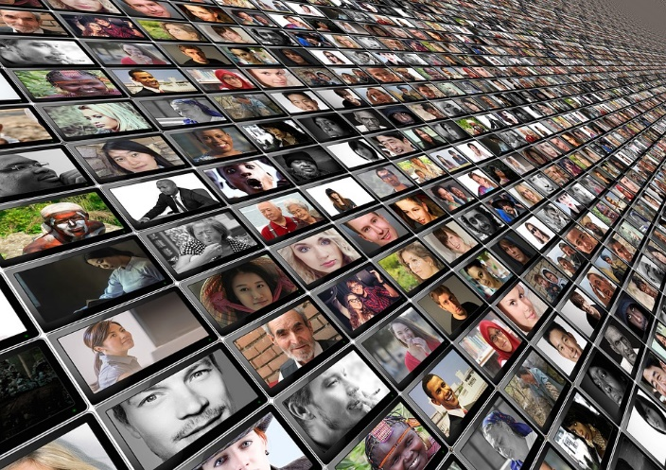
Big Data and Research
Notes:
Now let’s take a look at how Big Data is impacting research, specifically healthcare research. You’ll recall from an earlier slide that research has typically involved assembling a sample population and a control group. The data used is just a small subset of a particular group with characteristics of interest. When it comes to Big Data, we can essentially analyze the entire data set, not just a subset.

Slide 17
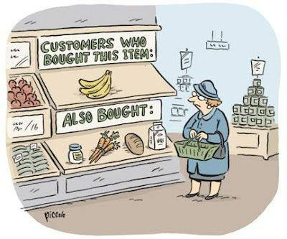
Big Data Mining
Collect Big Data or obtain access to a repository.
Perform data analysis to explore patterns (pattern recognition, predictive analytics).
Identify potential correlations.
4. Good enough!
©Rina Piccolo
Notes:
In order to do so, we need to either have the ability to collect or access huge data sets, perform analyses on them using platforms like Hadoop or supercomputers, and identify interesting correlations among the data. When it comes to Big Data, researchers are more interested in correlation, or the interrelationship between different data. Think Amazon recommendations. Amazon collects data on vast numbers of consumers and using that data, can predict that if you bought bananas, you’ll probably buy milk, as this cartoon illustrates.

Slide 18
Big Data in Health Care
Faster and cheaper technology and data storage
Widespread sensing devices
An increase in “born” digital data
Greater availability of data via repositories
Data sharing mandates
Notes:
Healthcare Big Data is now starting to catch up with Big Data in the business world. How is this so?

Slide 19
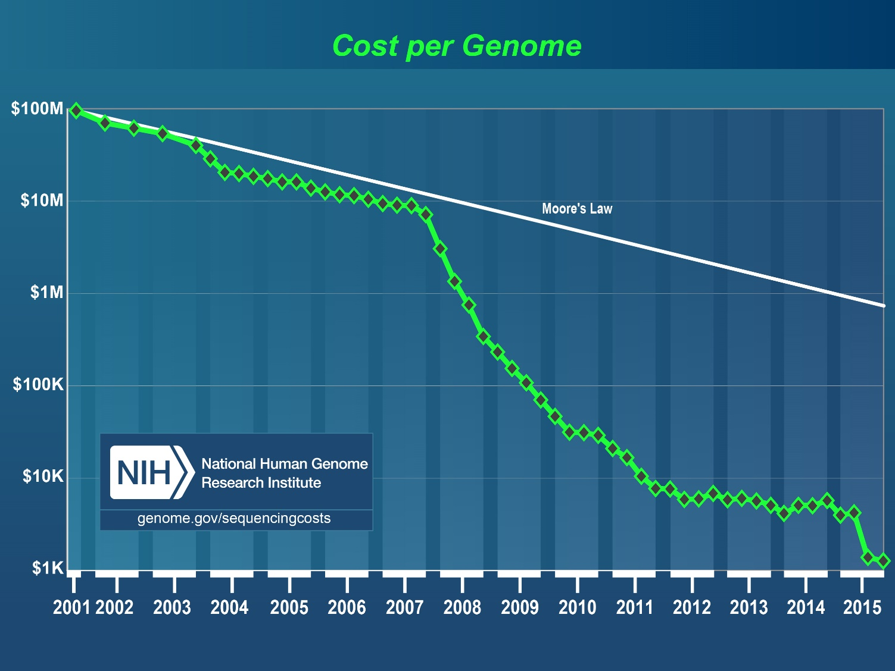
Faster and cheaper technology and data storage
The cost to sequence a whole human genome sequence has fallen from +$100 million to less than $1,000 over the past 15 years.
Notes:
In less than 15 years, the cost to sequence the human genome has fallen from over $100 million to less than $1,000. This is just one example of how faster and cheaper technology and data storage has pushed down costs.
https://www.genome.gov/sequencingcosts/

Slide 20
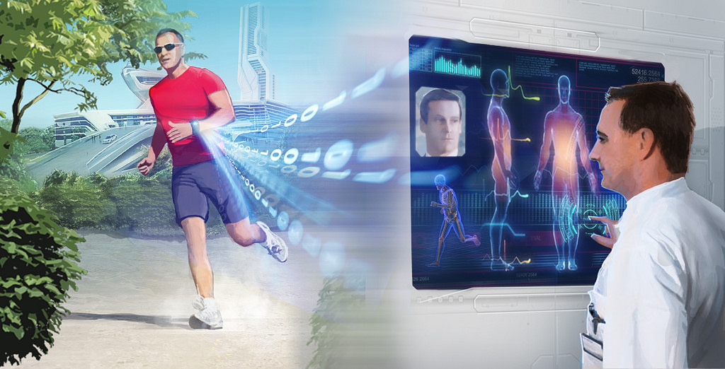
Sensing devices
Smartwatches
Smart jewelry
Fitness trackers
Sport watches
Smart glasses
Smart clothing…
Notes:
Personal sensing devices are showing up in more places, are becoming more advanced, and are also becoming less expensive.

Slide 21
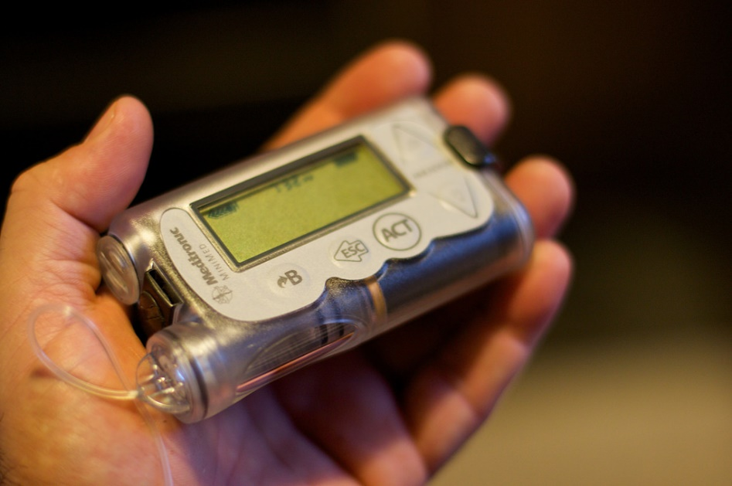

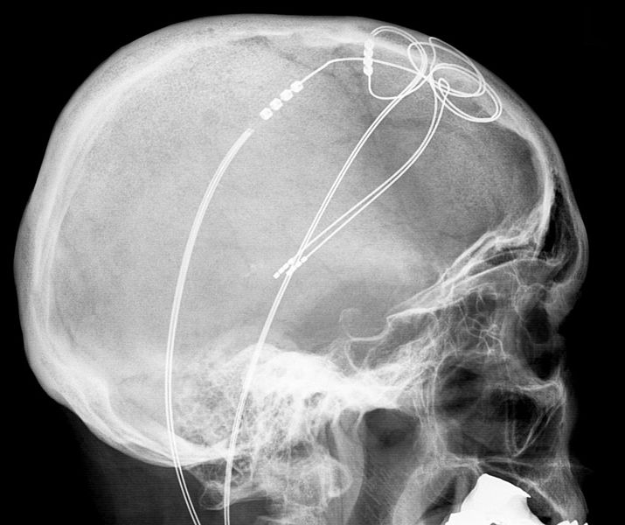
An increase in “born” digital data
© Alan Levine
© NEC Corporation of America
Data that originates as digital data, rather than being converted or digitized later is proliferating. Think digital electronic medical records, implanted medical devices, diagnostic imaging technology…
©Hellerhoff
Notes:
“Born” digital data is data that began it’s existence already digitalized and is therefore more readily collectable and analyzable. Think digital electronic medical records, implanted medical devices such as insulin pumps and neurostimulators, diagnostic imaging technology, and physiologic monitoring devices of every kind…

Slide 22



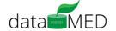
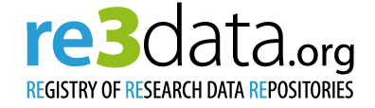










Greater availability of data via repositories
As of April 2016 the Registry of Research Data Repositories (re3data.org) listed 1,500 research data repositories. Currently 458 are key worded “medicine.”
Notes:
The number of data repositories are exploding and specialize in a huge range of different areas, from images of tumors to genetic data, to infectious disease data. An that’s just in healthcare. Data repositories help to ensure that data is findable, accessible, interoperable, and re-usable.

Slide 23






Sharing mandates
The number of funders and journals with data sharing policies has grown significantly in the past decade…
Notes:
And in the past decade, more grant funders and peer reviewed journals are requesting that researchers submit not only their research paper, but also the raw data that underlies their work. As you can imagine, this is a contentious issue. Researchers may not have the time, funding, or expertise to prepare their data for submission. And they may worry that submitting their data will expose them to being “scooped” by other researchers.

Slide 24
The Health Care Big Data Horizon
Leverage the Electronic Health Record to improve diagnosis, outcomes, and reduce costs
Integrate patient-generated health data and the Internet of Things (IoT)
Incorporate environmental and socioeconomic data in patient diagnosis and treatment
Develop personalized care specific to each patient’s particular needs (Precision Medicine)
Notes:
So what possibilities are starting to appear on the health care Big Data horizon?...
Some of your may be familiar with what is meant by the Electronic Health Record. In the past decade, the government has mandated that health care providers move the traditionally print-based medical record to an electronic format. The EHR has the potential to be mined for a vast amount of information that will contribute to improving patient diagnosis, health outcomes, and to reducing healthcare costs, fraud, and waste.
Patient-generated health data from personal monitoring devices and data from computing devices embedded in everyday objects (the Internet of Things) will provide much richer information on which to base personal healthcare decisions.
Things such as air pollution and pollen data will assist care givers in anticipating the benefit of preventive measures.
Precision Medicine, by taking into account an individual’s genetic makeup, environment, and lifestyle will allow much more customized, targeted healthcare. The National Institutes of Health is currently initiating a program called All of Us. It is a historic effort to gather data from one million or more people living in the US with the goal of accelerating research and improving health. “By taking into account individual differences in lifestyle, environment, and biology, researcher will uncover paths toward delivering precision medicine.” More information will be available from NIH soon.
https://mapr.com/blog/5-big-data-trends-healthcare-2017/
http://www.mckinsey.com/industries/healthcare-systems-and-services/our-insights/the-big-data-revolution-in-us-health-care
http://healthitanalytics.com/news/understanding-the-growth-value-of-healthcare-big-data-analytics

Slide 25
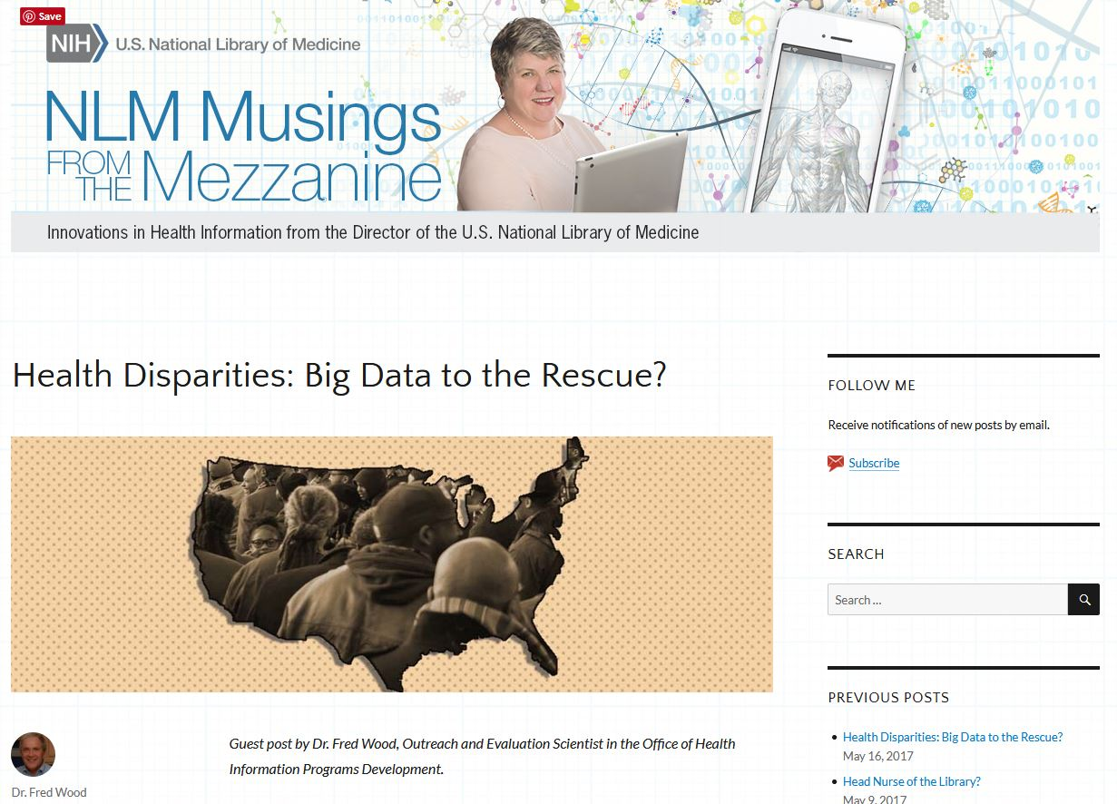
Health Disparities: Big Data to the Rescue?
Notes:
Just last week, the director of the NLM, Patti Brennan, invited guest blogger Dr. Fred Wood, Outreach and Evaluation Scientist in the Office of Information Programs Development, to post on the potential intersection between Big Data and Health Disparities. He commented on a special issue of last month’s Ethnicity & Disease that focused on Big Data and it’s applications to health disparities research. I encourage you to read the article titled, ““Big Data Science: Opportunities and Challenges to Address Minority Health and Health Disparities in the 21st Century.” If you are interested in this issue.
https://nlmdirector.nlm.nih.gov/2017/05/16/health-disparities-big-data/
https://ethndis.org/edonline/index.php/ethndis/article/view/665/830

Slide 26
“Big Data” on PubMed
Notes:
A quick search of the term “big data” on PubMed gives a good indication of just how quickly “Big Data” is infiltrating the world of healthcare, from just two articles mentioning that term in 2003 to over 1000 in 2016.

Slide 27
Hurdles and Risks
Unstructured Data (~75% of data in the healthcare environment)
Data privacy/security (HIPAA Compliance, Patient Confidentiality, Personally Identifiable Information/PII)
Inconsistent, incomplete , unavailable, poor quality or invalid data
Poor analysis/analytics leading to erroneous correlations/conclusions
Misused data
Notes:
What are some of the hurdles healthcare must overcome to achieve these benefits? And what are some of the risks?
Much of the data found in Electronic Medical Records is unstructured data in the form of text, making in particularly challenging to aggregate or group and analyze it in a consistent manner. In addition, the data can have inconsistent or variable definitions, varying levels of complexity, and may originate in a number of different places.
Healthcare data is also highly regulated to insure privacy and confidentiality. It is illegal to share access to patient records and data must be de-identified before it is shared. This means removing any data that would allow someone to identify the individuals represented: name, date of birth, date of death, address, phone number, etc. Removing these identifiers is critical and even after the data is shared, the recipients of the data must agree to store and access the raw data in a prescribed way.
Just like any type of information, data can also be misused. Genetic data, and data on preexisting conditions could, in the wrong hands, impact an individual’s ability to obtain employment, or health insurance…
http://data-informed.com/the-5-biggest-risks-of-big-data/
https://www.healthcatalyst.com/5-reasons-healthcare-data-is-difficult-to-measure
https://sites.duke.edu/rethinkingclinicaltrials/acquiring-and-using-electronic-health-record-data/

Slide 28
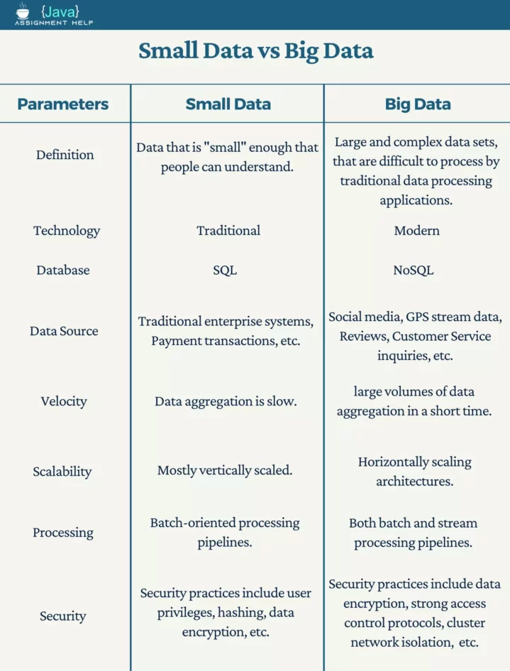

Slide 29
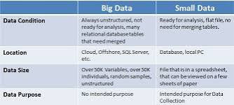

Slide 30
Resources…
DataMed https://datamed.org/
Institute for Health Metrics and Evaluation’s Global Health Data Exchange http://ghdx.healthdata.org/
NNLM RD3: Resources for Data-Driven Discovery https://nnlm.gov/data/
NNLM’s YouTube Channel https://www.youtube.com/channel/UCmZqoegBFKJQF69V8d-05Bw
OHSU’s Big Data to Knowledge https://dmice.ohsu.edu/bd2k/topics.html
Registry of Research Data Repositories (re3data.org) http://www.re3data.org/
NIH’s All of Us Program https://allofus.nih.gov/

Slide 31
References
Borgman, Christine L. Big data, little data, no data: Scholarship in the networked world. MIT Press, 2015.
Federer, Lisa. Beyond the SEA: Data Science 101: An introduction for librarians https://www.youtube.com/watch?v=i78ciP1eGxo&t=3s
Mayer-Schönberger, Viktor, and Kenneth Cukier. Big data: A revolution that will transform how we live, work and think. Houghton Mifflin Harcourt, 2013.
Notes:
If you are interested in the wider world of Big Data, the two books listed on this slide will be of interest.

